Slide 1


A complete, intelligent, secure solution to empower employees.
Office 365
Windows 10
Enterprise Mobility + Security

Slide 2

Microsoft mission
“The most profound technologies are those that disappear. They weave themselves into the fabric of everyday life until they are indistinguishable from it.”
Empower every person and every organization on the planet to achieve more
Mark Weiser

Slide 3

The changing modern workplace
Mobile and social
45% use social tools at work
4X as many devices per user
Diverse and global
5 generations together in the workforce
72% of workers will be working remotely by 2020
Team-based and collaborative
2x as many teams
80% of employee time is spent collaborating

Slide 4




New partner opportunities
1
2
3
4
Enable the hub for Teamwork
Meetings and Calling
Connect the workforce
Modernize the intranet
Team lifecycle management
SharePoint integration
Custom solutions
Devices and room systems
Cloud video interoperability
Calling plans / Direct Routing
Leadership connection
Employee communities
Firstline Workers
Communication sites
Video portals
Enterprise search

Slide 5
Evolving partner business model
-
18%
10%
17%
14%
+
+
+
Advisory & adoption
Business solutions
Managed services
Deployment
Forrester 2018 Microsoft 365 Enterprise TEI study commissioned by Microsoft, year over year.

Slide 6
Teamwork Partner Revenue Opportunity
Security
$26
Compliance
Teamwork
User/month¹
Modern Desktop
1. Forrester 2018 Microsoft 365 Enterprise TEI study commissioned by Microsoft

Slide 7
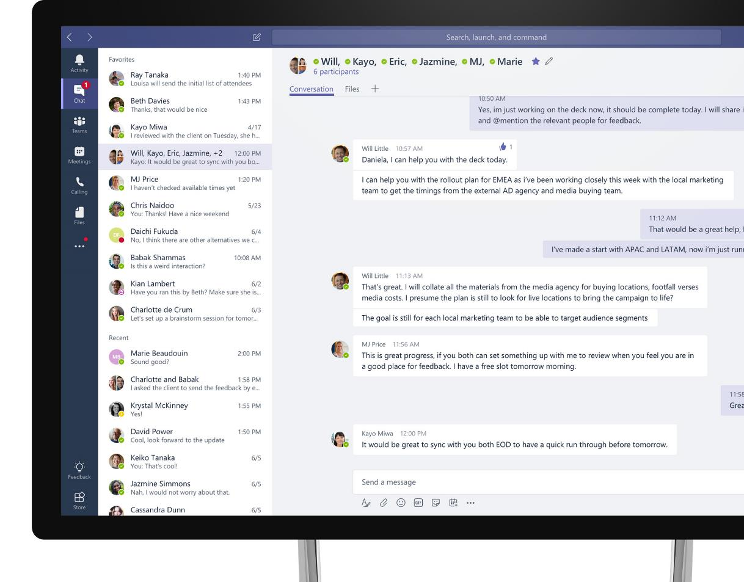
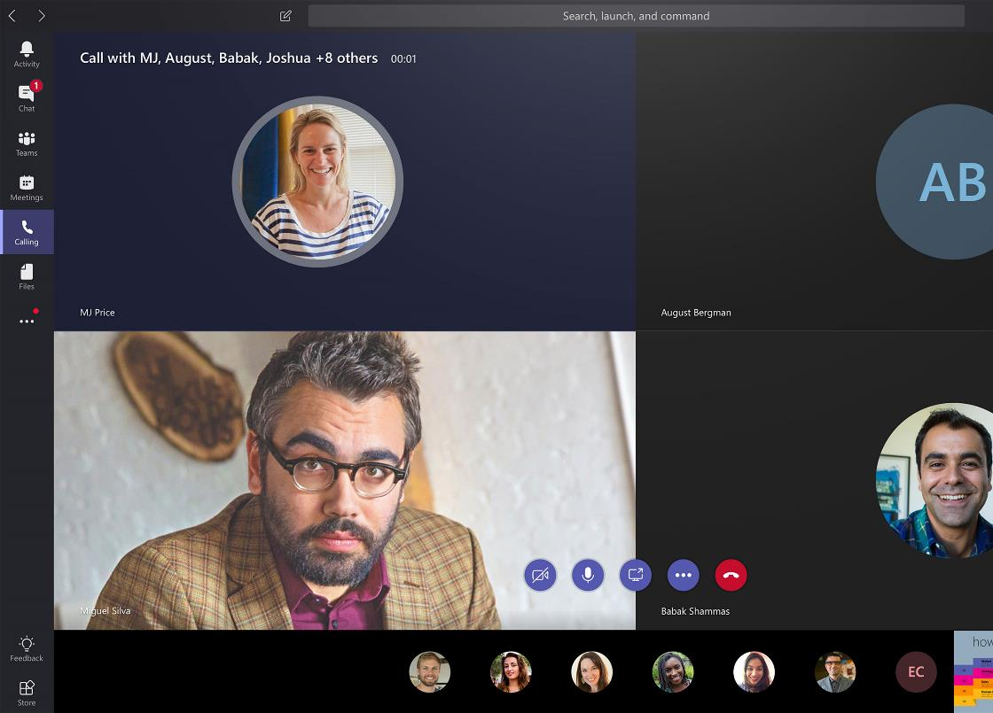
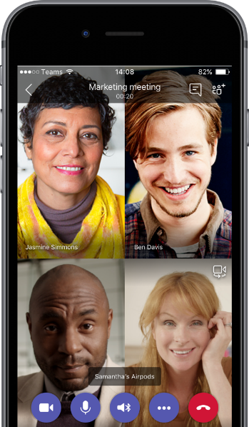
Microsoft Teams
The hub for teamwork in Office 365
Communicate
through chat, meetings & calls
Collaborate
with deeply integrated Office 365 apps
Customize & extend
with 3rd party apps, processes, and devices
Work with confidence
enterprise level security, compliance, and manageability

Slide 8

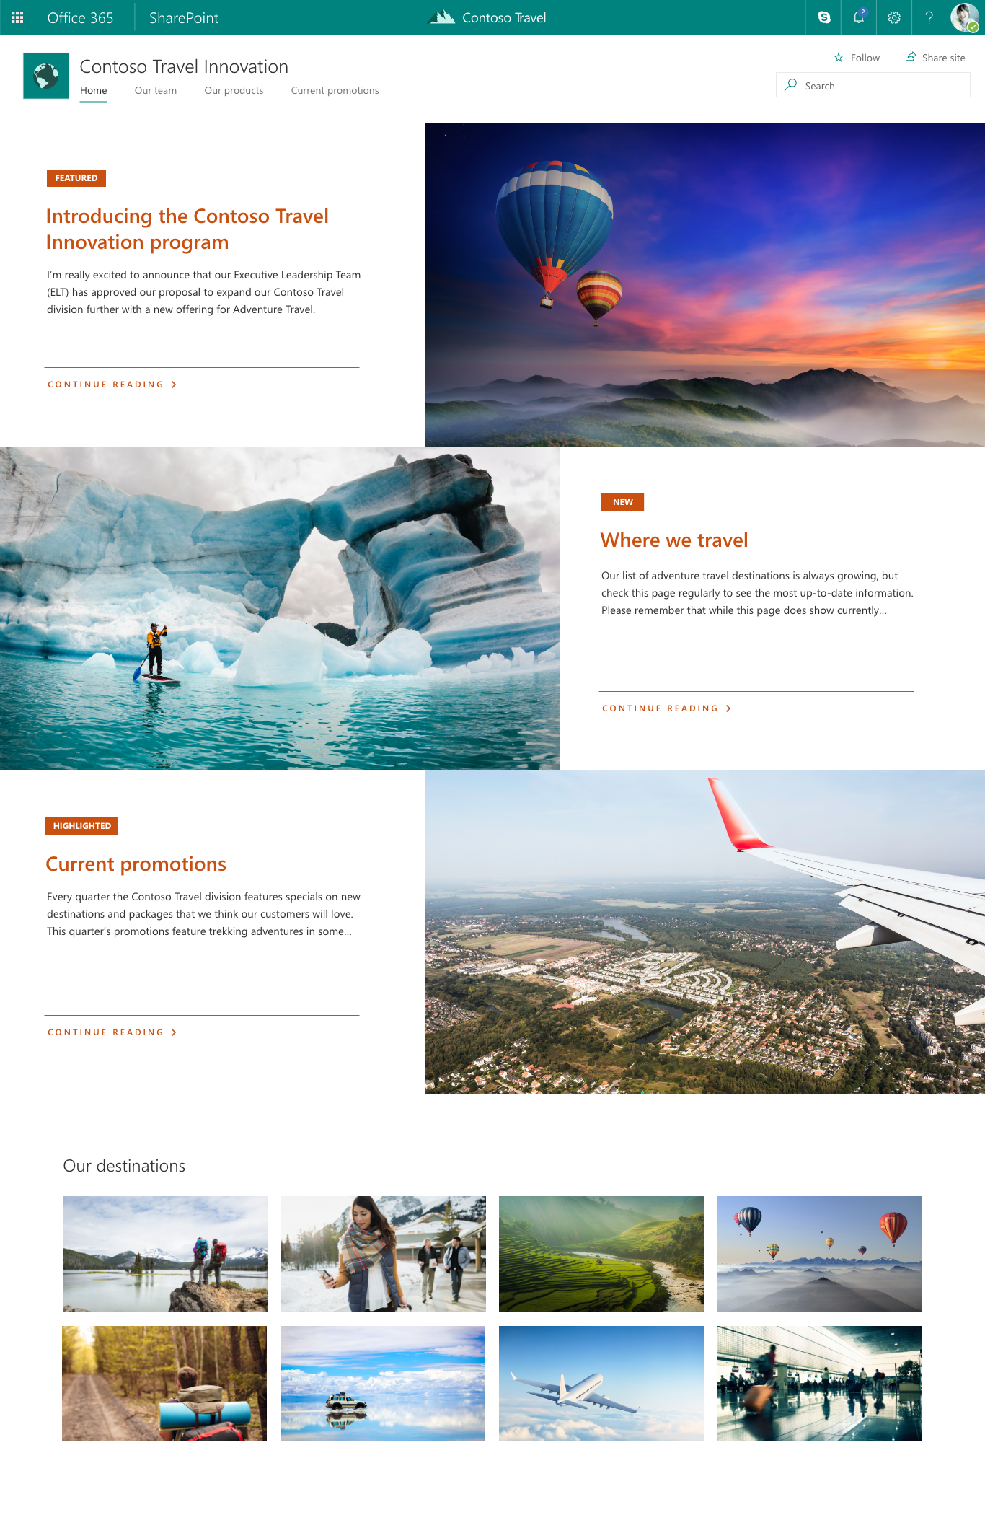
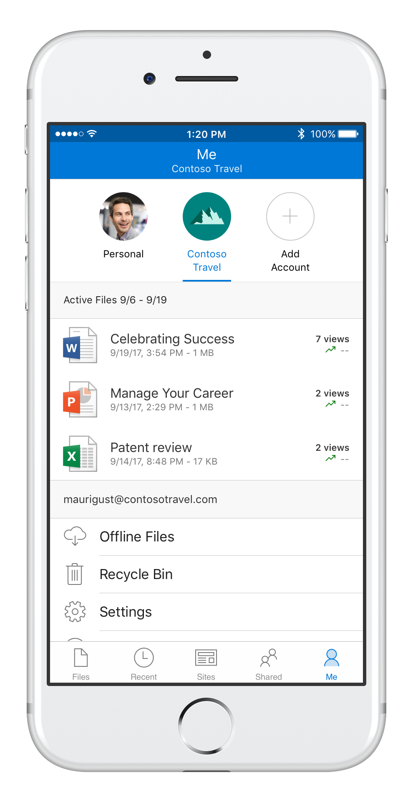
Modern SharePoint Content collaboration for the modern workplace
Beautiful, responsive intranets
communicate and engage employees
Content services
shared files, pages, data and apps across Office 365
Modern solutions framework
no-code apps, workflow, and custom development
Anywhere access to files
simple and secure sharing with OneDrive
Intelligent intranet & search
connect people, sites, news and knowledge

Slide 9

"The most strategic developer surface area for us is Office 365."
- Satya Nadella, CEO, Microsoft

Slide 10
Why develop on the Office 365 platform?
For Customers
Fill industry-specific gaps in Office 365 compliance and other scenarios
For Partners
Streamline work by integrating LOB and collaboration
Reduce the learning curve by building on tools users already know
Ongoing revenue opportunities “after the migration”
Lower cost and time to market of business applications
Keep up as Microsoft modernizes its collaboration stack
Build on the momentum of Office 365
Reduced hosting costs by moving work to customer’s O365 tenant
For Everyone
Complete the last 10% of migrations: customizations from legacy collaboration environment (e.g. SharePoint on premises)
Faster time to market for new applications
Bring teamwork into business applications
BENEFITS

Slide 11

Developer opportunity
Users
135M+ monthly active commercial Office 365 users
35% growth in O365 commercial seats
90% of Fortune 500 have the Microsoft Cloud
Data
4T+ emails sent with Office 365
3B minutes of Teams and Skype calls daily
2B+ meetings created per month
Intelligence
8T+ nodes in the Microsoft Graph

Slide 12

Office 365 Application Ecosystem
Apps
15K+ new apps created to connect to O365 monthly
Usage
>250K centralized add-in deployments
400% growth in share of users with 3rd-party app
>200% increase in monthly active users of 3rd party Microsoft Graph applications in last year

Slide 13
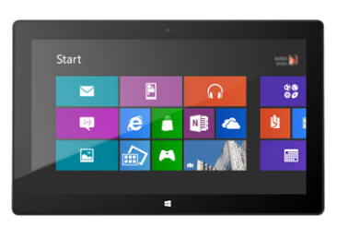

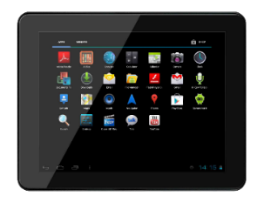
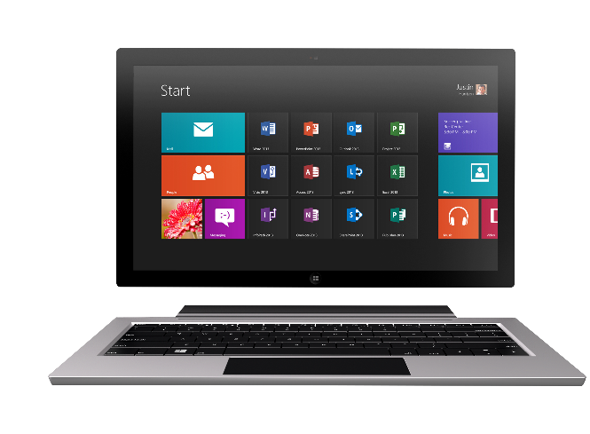
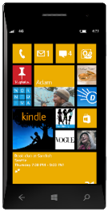

Changing Technology Landscape
1990s PC
2000s PC + Servers
2010s Devices + Cloud

Slide 14
Evolution of the Office Platform
1990s PC
2000s PC + Servers
2010s Devices + Cloud
VBA
Com Add-ins
VSTO
FTC
Open standards
Decoupled services
Mobile SDK’s

Slide 15








Shift in solution model
LEGACY MODEL
APP MODEL
USER’S MACHINE
Add in
CLOUD SOLUTION
(running on any cloud platform)
Add in
Files SVS
3rd Party Data SVS
SHAREPOINT SERVER
.NET
Document SVS
Notes SVS
Presentation SVS
Spreadsheet SVS
Communication SVS
Mail SVS
Calendar SVS

Slide 16






Office 365 as a Platform
Packaged Solutions
PowerApps and Flow
Reference solutions
Custom development
Custom development
Notes:
Customers can:
- use packaged solutions from AppSource
- use low/no-code options like PowerApps and Flow
- begin from an open source reference solution
- start from scratch with completely custom development

Slide 17









Office 365 Platform
Extensions
Standalone web, device, and service apps
Documents
Pages


Conversations
Embedded canvases
Canvases
1
Insights
Conversations
People
Files
Groups
Microsoft Graph
Notes:
You can plug into this via the Graph API.
There are a lot of “canvases” where people work, where you can develop apps.
Some canvases can be embedded in your apps – e.g. hosting Skype 4 Biz, or Word and Excel via cloud storage partner program

Slide 18
Microsoft Graph
Files
Insights
Conversations
People
Groups
Notes:
Microsoft graph began with people in the directory. People, groups, and relationships (e.g. a manager, a group member)
Then content like files
Then conversations in Skype 4 Biz, email, teams, online meetings; even conversations in Word comments
Then insights gathered by learning from all that information

Slide 19
REMAIN CALM
AND
KEEP THIS SLIDE
Microsoft Graph
Files
Insights
Conversations
People
It is necessary for the build effect to the next slide.
Groups

Slide 20
Microsoft Graph

Slide 21



Emerging Patterns with MS Graph
Rich context
Is this person out of the office?
Who is their manager?
Where do they need to be next?
What documents have they been working on recently?
Deep insights
What documents are most interesting to this person?
What’s the best time for this group of people to meet?
Who should this person contact for info on this topic?
Smart Pickers
Graph-Connected Devices
Graph-Powered Bots
Real-time updates
Reschedule meeting when a conflict appears
Notify owner when a file is modified
Continue a process immediately after approval mail is received
Intelligent Business Process

Slide 22
Demo Microsoft Graph Explorer
https://bit.ly/GraphExplorer

Slide 23







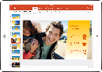

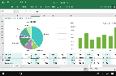
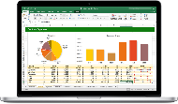


Web technologies
Cross
platform
Make your solution part of Office canvases
Extend Office applications across platforms using web technologies
Modern distribution
Store
Organization Catalog

Slide 24
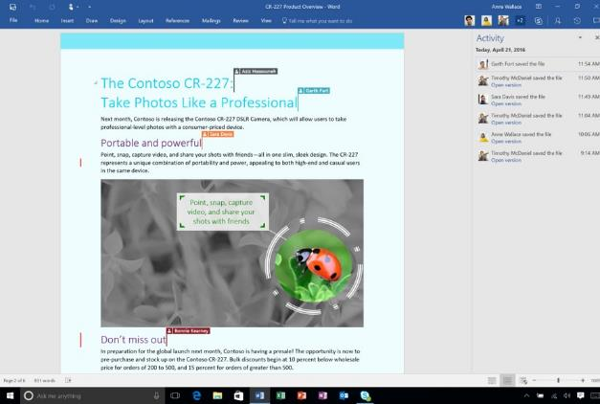
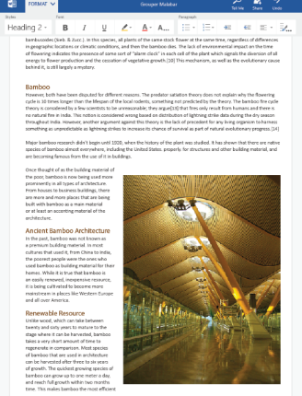
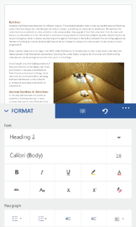

Document Canvas

Core experiences in Word, Excel, PowerPoint
Office Web Add-ins for extensions and custom content on Windows, Mac, Office Online, and iPad
Embeddable canvas through the Cloud Storage Partner Program

Slide 25
Document Canvas

Core experiences in Word, Excel, PowerPoint
Office Web Add-ins for extensions and custom content on Windows, Mac, Office Online, and iPad
Embeddable canvas through the Cloud Storage Partner Program

Slide 26
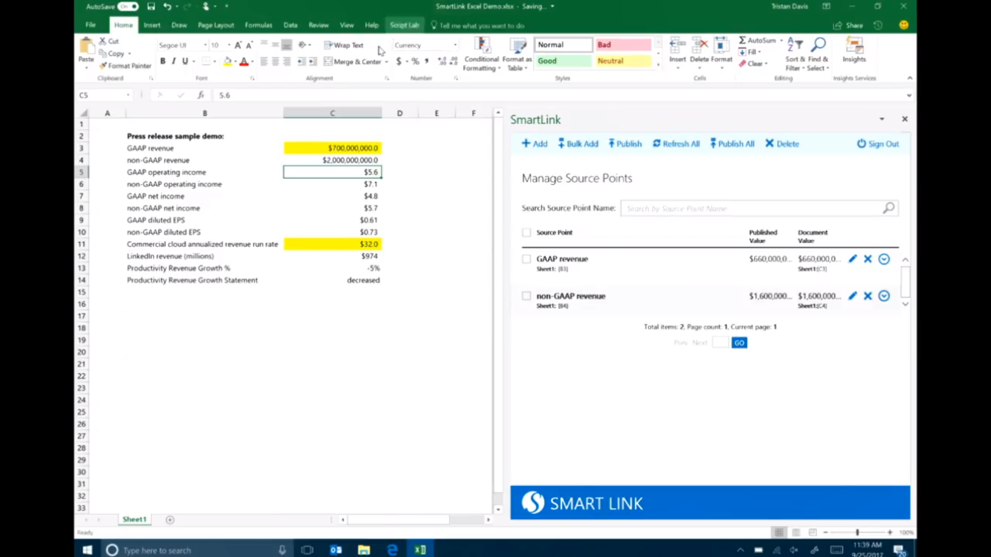
Notes:
This is an app called SmartLink – from the forthcoming reference solutions

Slide 27
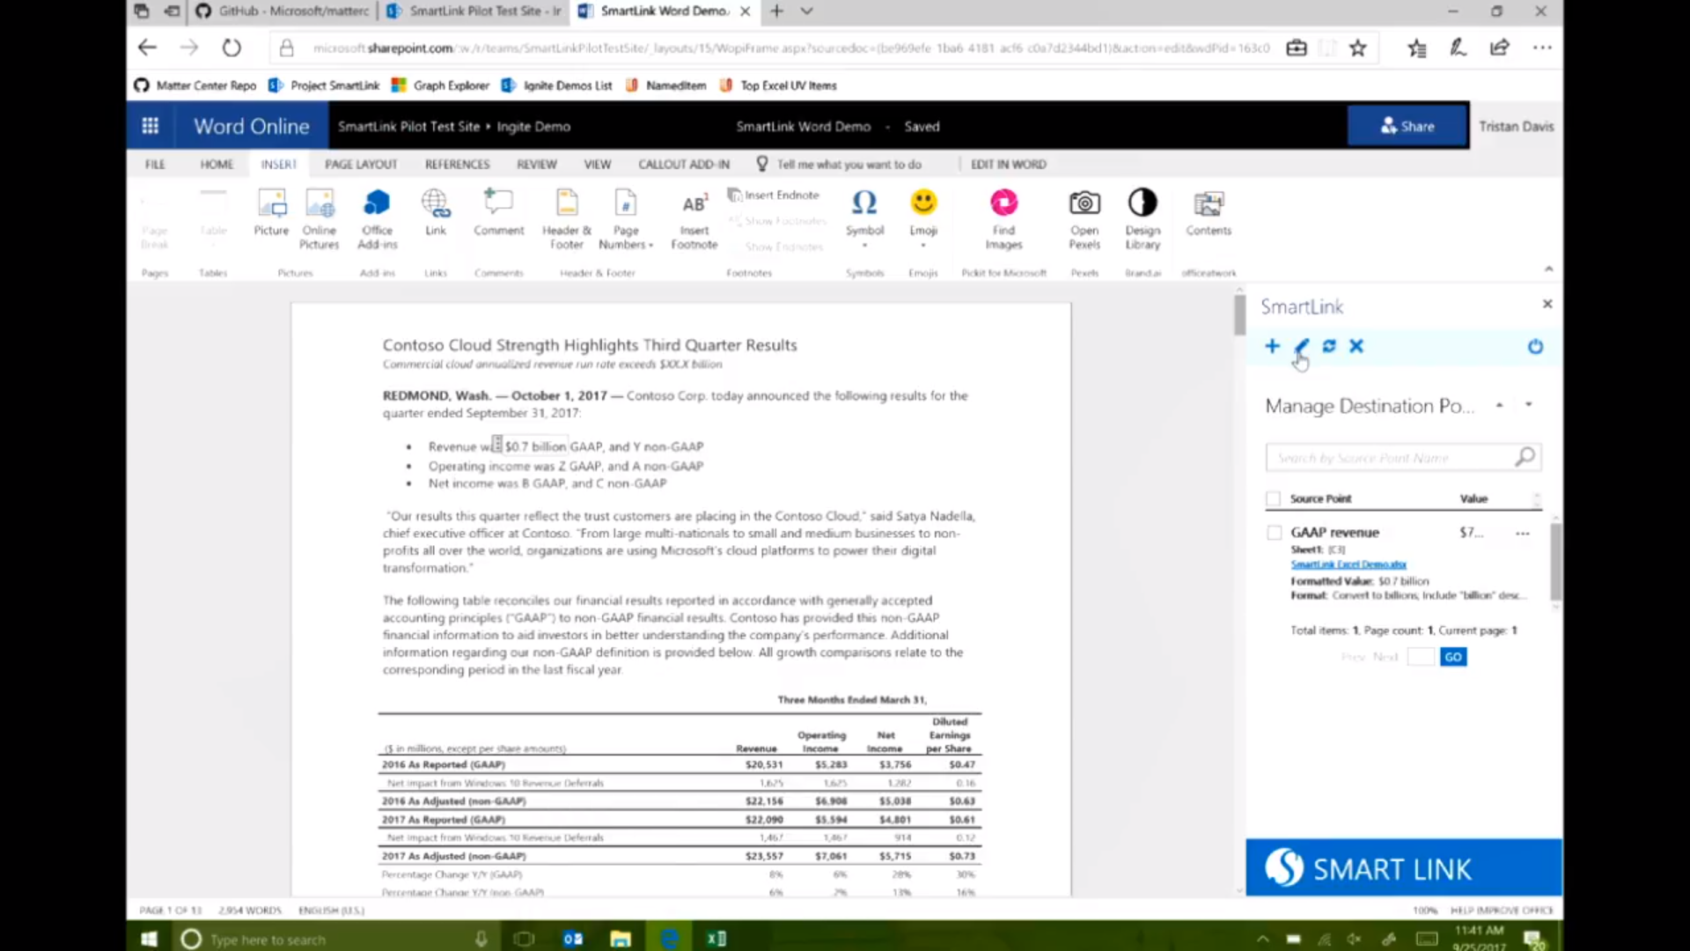

Slide 28
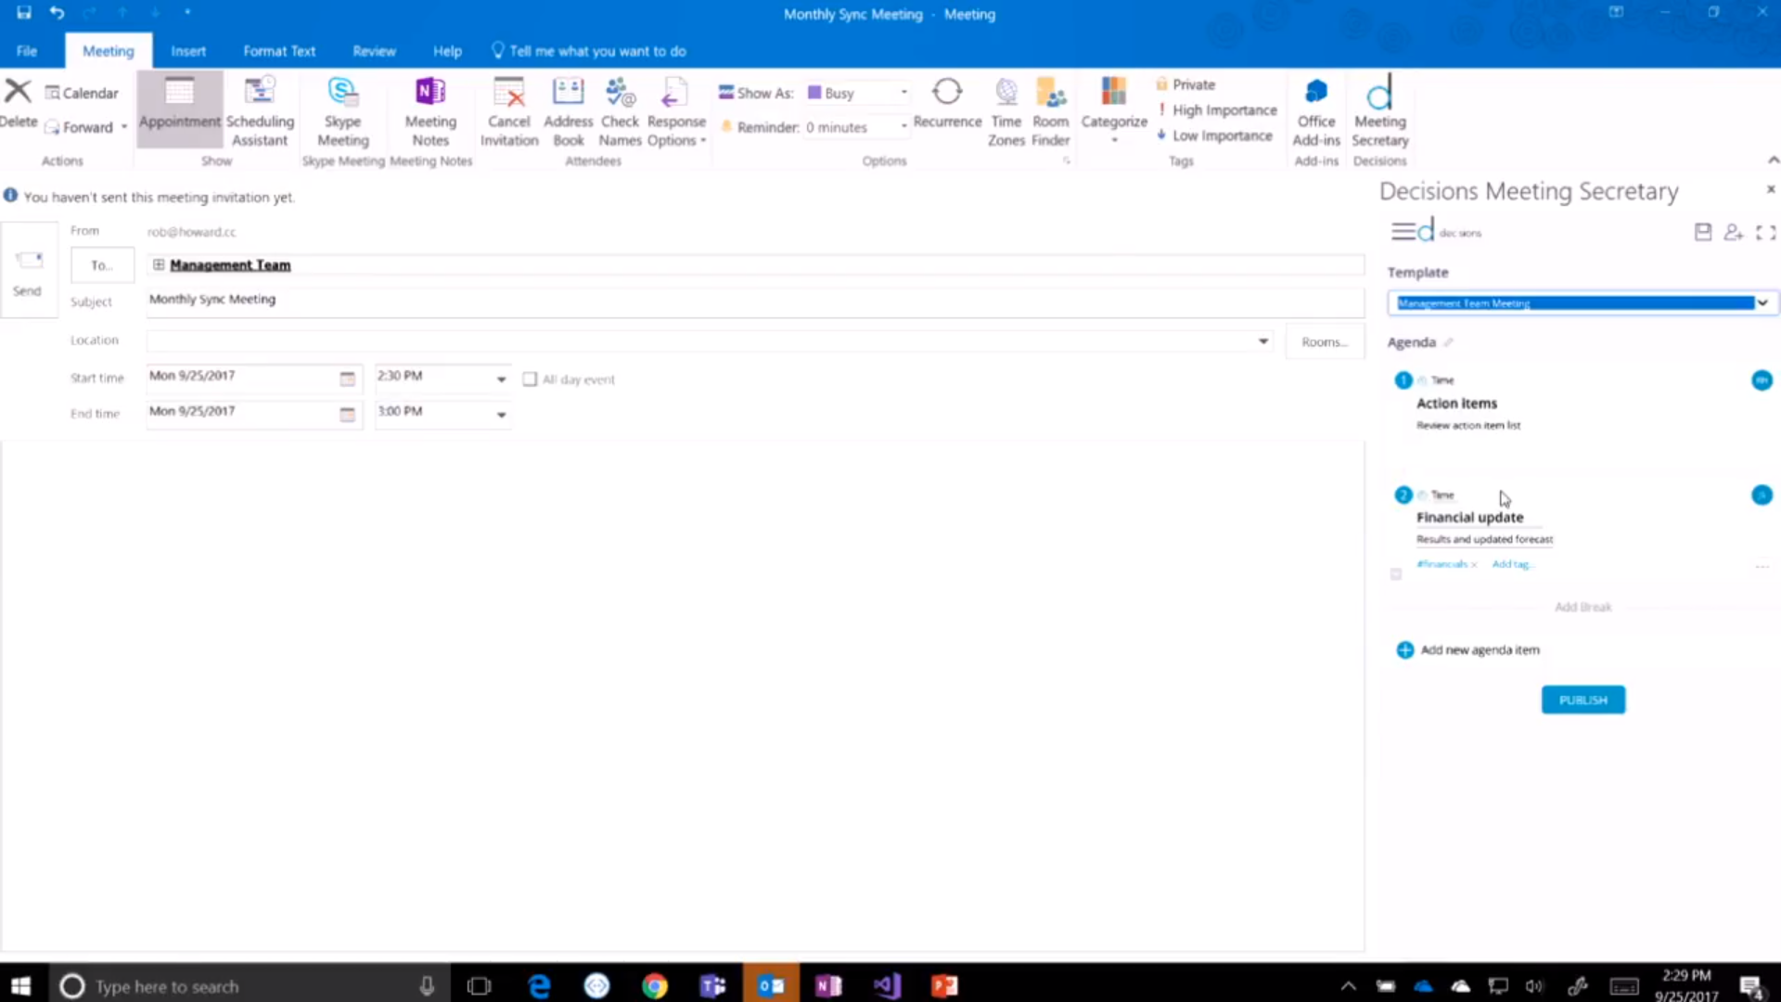
Notes:
This is from a 3rd party app called Decisions – available in AppSource
Plan your meeting w/a template right in outlook …

Slide 29
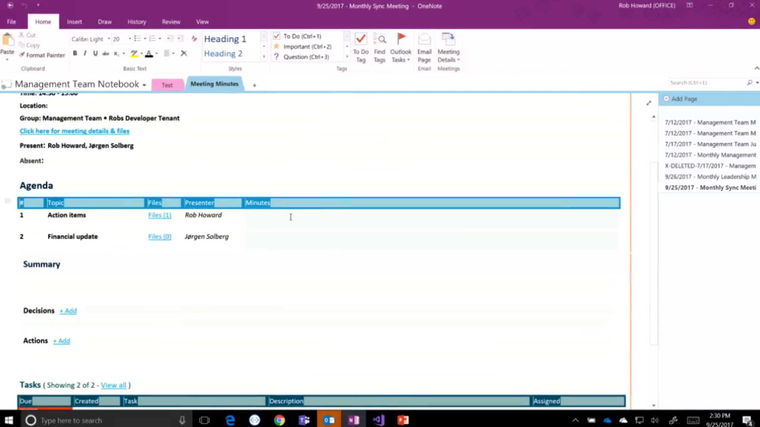
Notes:
… and the agenda is automatically transferred to OneNote for easier recording of minutes

Slide 30
Demo Script Lab Add-In
Notes:
Go to O365 Admin / Settings / Services & Add-ins
+ Upload Add-in
Search for Script Lab (it’s already installed)
Make a new Excel workbook
Wait a sec – SCRIPTLAB tab appears
Select a range of cells and run 1st example (turns them yellow)
Try the Report example too

Slide 31
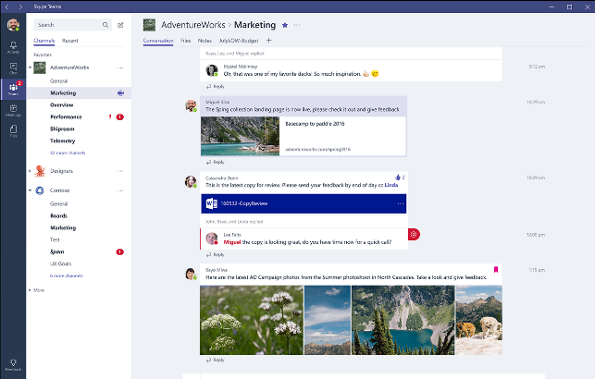
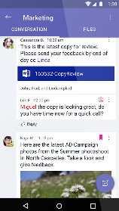
Conversation Canvas

Core experiences in Outlook, Teams, and Skype for Business
Extend conversations with Connectors and Bots
Custom content with actionable messages
Embeddable canvas with Skype for Business SDKs

Slide 32
Conversation Canvas

Core experiences in Outlook, Teams, and Skype for Business
Extend conversations with Connectors and Bots
Custom content with actionable messages
Embeddable canvas with Skype for Business SDKs

Slide 33
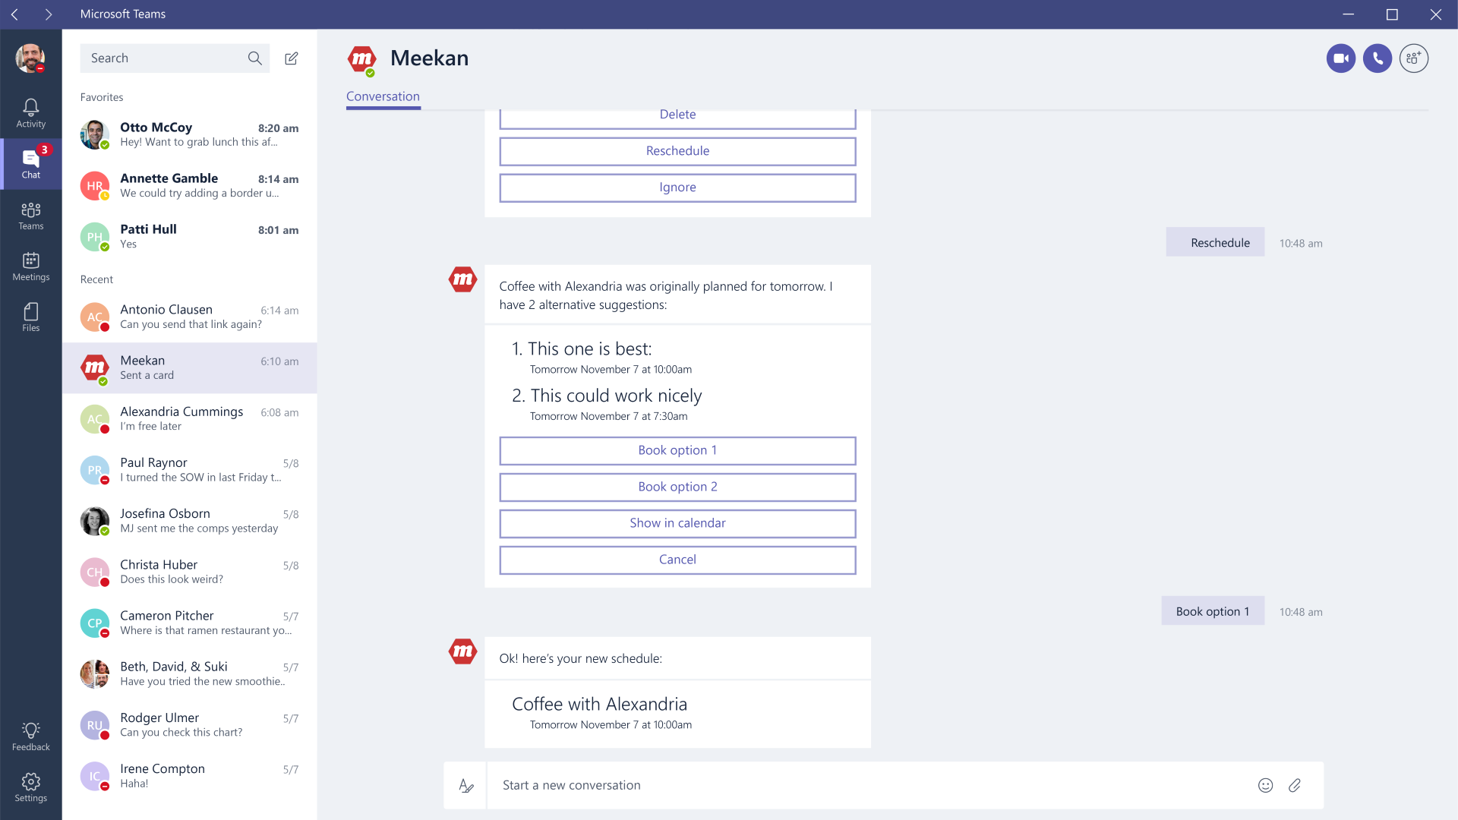

Slide 34
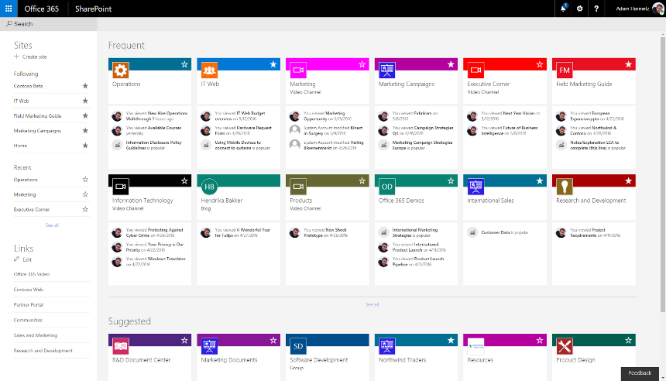
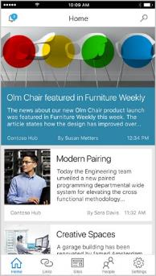
Page Canvas

Core experiences in SharePoint
Extend pages with SPFx Extensions
Custom content with SPFx web parts and SP Add-ins

Slide 35
Page Canvas

Core experiences in SharePoint
Extend pages with SPFx Extensions
Custom content with SPFx web parts and SP Add-ins

Slide 36
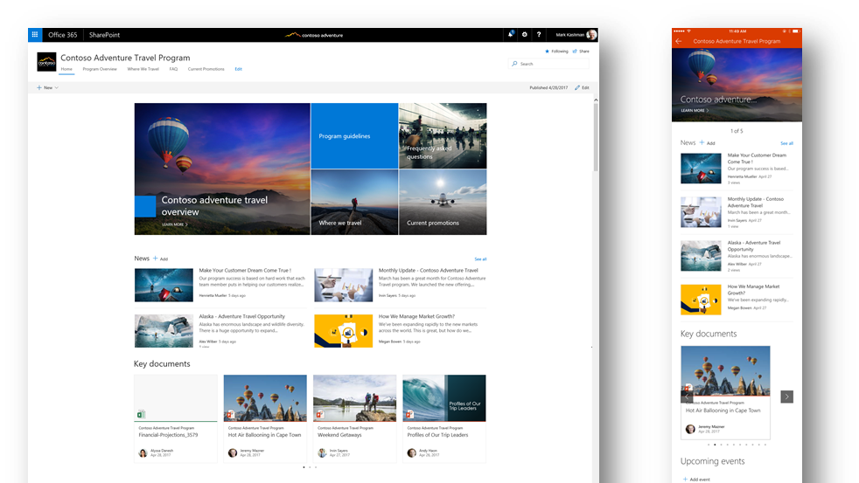

Slide 37

In review Session takeaways
Office 365 is a rich platform for building rich collaboration and productivity solutions
Graph API provides one-stop access across O365 features
User Experiences within O365:
Document Canvas – Office Add-ins
Conversation Canvas – Bots and Actionable Messages
Page Canvas – SharePoint Framework

